Slide 1
Neurograph Project
Jiashu Wu

Slide 2
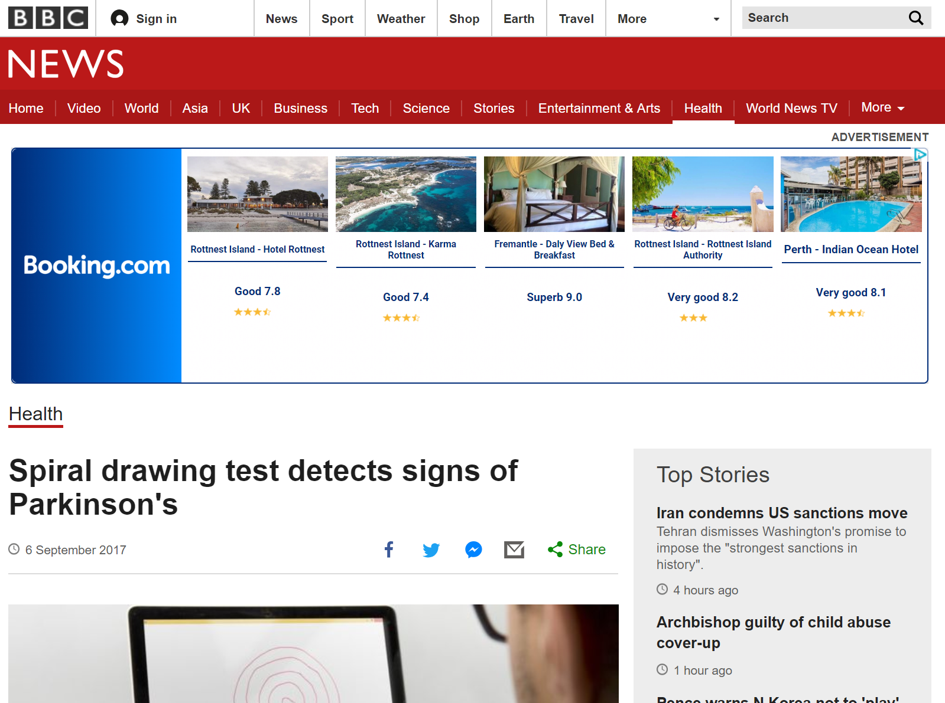
Use drawing to detect Parkinson’s Disease

Slide 3
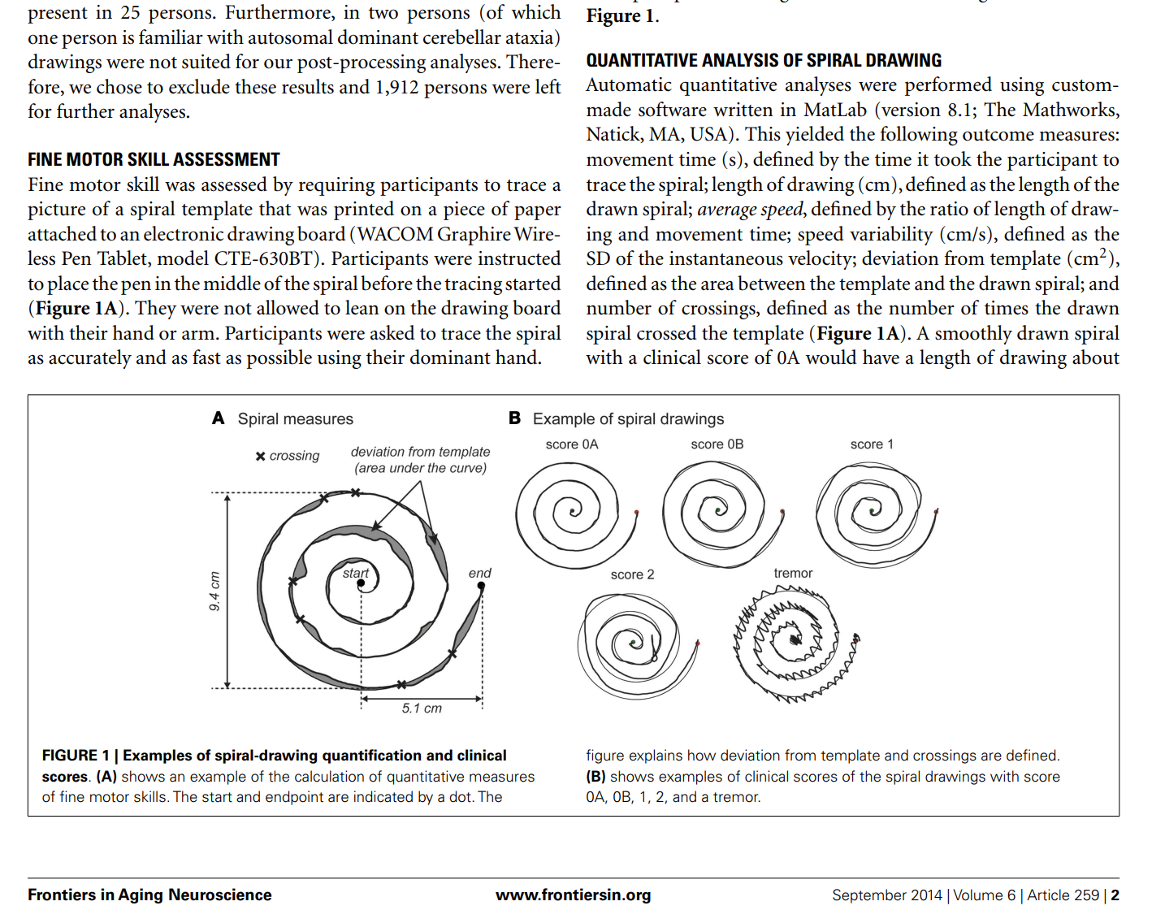
From the research papers

Slide 4
What this project is about
Part 1: An app which captures the drawing data
Part 2: Analyse the drawing data and study interesting features

Slide 5
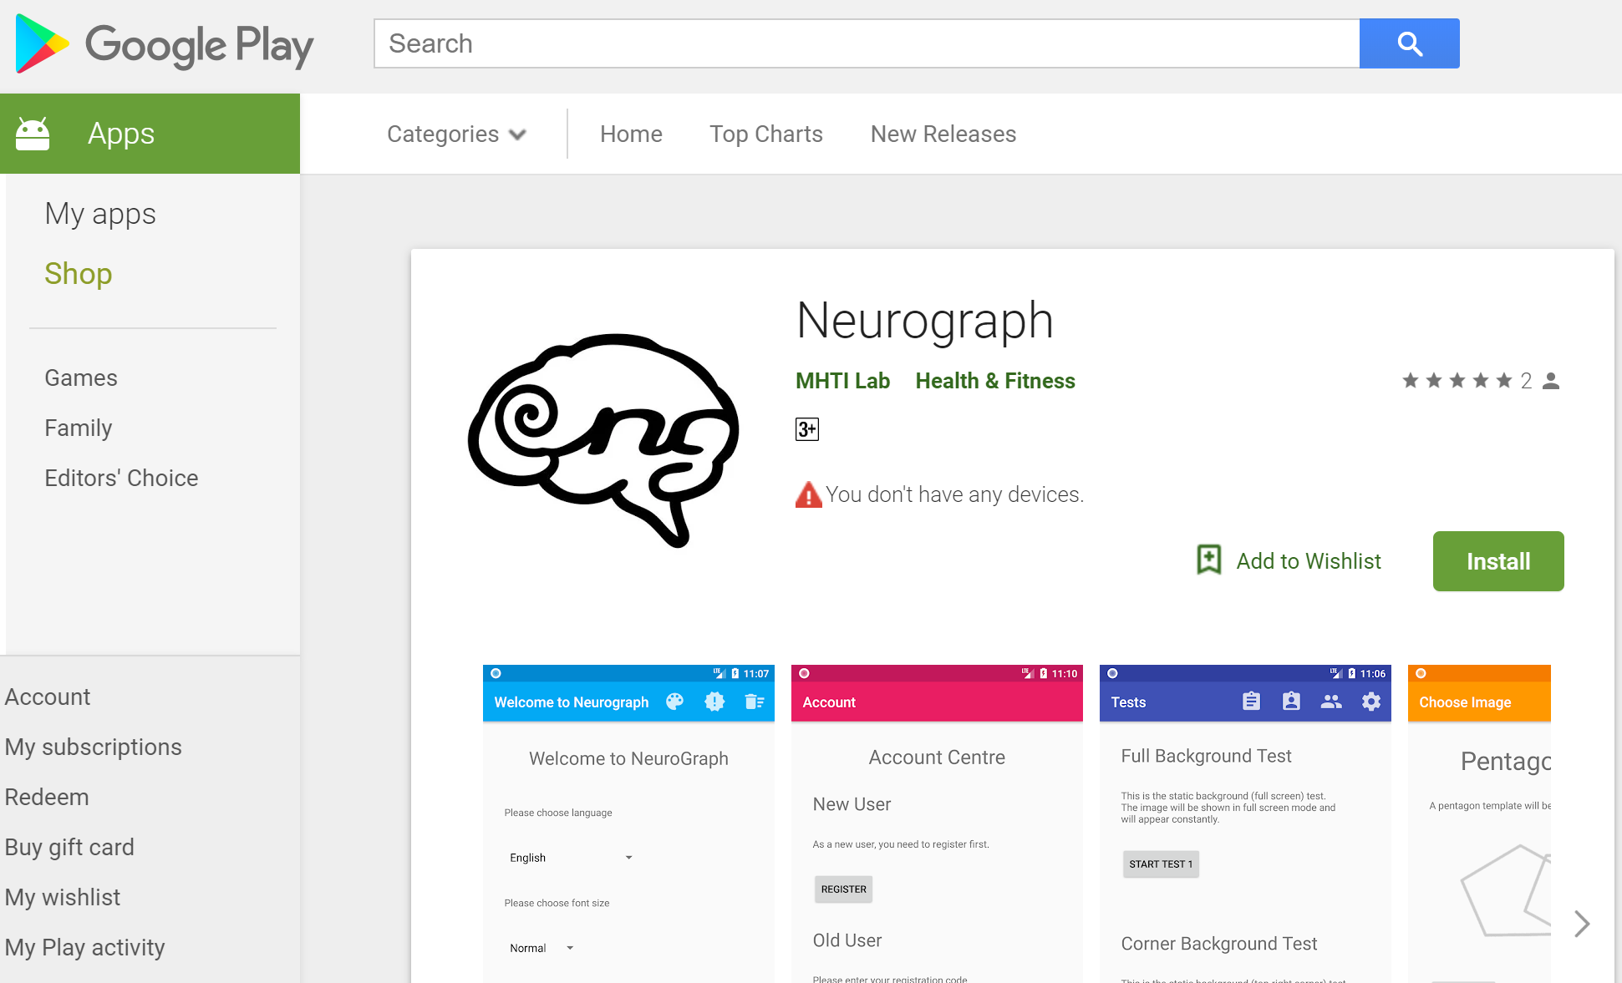
App demonstration

Slide 6
Data Files
After getting the drawing inputs, it will be stored in files in different format.

Slide 7
Q & A

Slide 8
Thank you ^_^

